Slide 1

Study Groups
How and Why
A WSU Student Support Services Study Skills Workshop
Compiled by Kathryn Rice Strebel

Slide 2

Why should I be in a study group?
People can accomplish more by sharing their skills and resources than by working alone.
Research supports the idea that learning in study groups works!
Study groups encourage consideration of multiple perspectives.
Students are engaged in critical and creative thinking while working in study groups.

Slide 3

Why should I be in a study group?
Study groups provide experience in building partnerships. These skills carry over to most careers.
Study groups give you practice working with others who are different than you.
Speaking in small groups will prepare you for speaking to larger groups in the future.

Slide 4

Why should I be in a study group?
Study groups help you notice something you may have missed.
Because study groups meet in advance of a due date, you are not as apt to procrastinate.
Most people learn faster in study groups. Something confusing to you may be clear to another person that may be able to explain it.

Slide 5
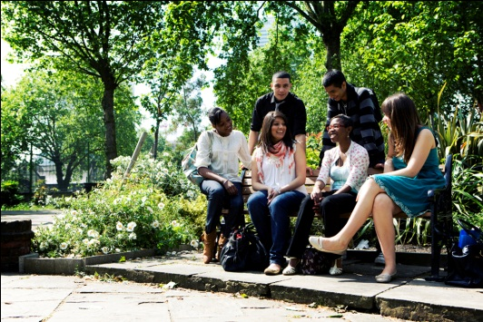
Why should I be in a study group?
You may learn new study skills.
In groups you have someone to discuss the topic with when you start struggling.
Being in a study group can potentially make study time more enjoyable.
Study groups provide a way for you to fill in gaps in your notes.
If you have to miss class someone in the group can tell you what you missed.

Slide 6
Why should I be in a study group?
Summary of why you may want to participate in a study group.
Meet others.
Make friends.
Improve your leadership skills.
Get experience working as a team.
Save time.
Learn more.
See new perspectives and expand your thinking on a topic.
Have a back-up person in case you get sick or hurt.

Slide 7

Here are some tips on how to form a successful study group.
All groups are not equal.
Choose your companions carefully.
Work with those that motivate and inspire rather than someone looking for an easy ride or a way out of doing an assignment.
Look for people who stay alert in class, take notes, ask questions and answer professor’s questions.
Start your group early in the semester if possible.

Slide 8
How to form a successful study group
Limit the size of your group to three to six. Too many may add confusion and cause scheduling times to meet difficult.
Do the reading and homework before meeting. If you are not prepared your group will not work.
  You won’t have time to do all of your studying in the group meeting time.
Try out the group at first to see if it will work.
Establish a regular meeting place and time if you decide it will work.
Decide in advance how long your session will be and stick to it.
.

Slide 9

How to form a successful study group
Share contact information.
When speaking be brief and make sure what you say is clear and relevant.
Don’t dominate the entire conversation.
Give each person a turn talking and asking questions.

Slide 10

Tips
Encourage each other.
Discuss strengths of each person at your first meeting.
Take turns being the group moderator.
  This person keeps the group on track.
Stay on task most of the time.
Meet at least once a week.
Make a commitment for each member to show up, be on time and be prepared.

Slide 11
How to form a successful study group
Predict test questions and quiz each other.
Compare notes.
Make and use flash cards to quiz yourself and each other.
Schedule times to prepare for tests.
Make up poems or songs to remember important concepts.
At the end of the meeting summarize and evaluate. Take at least 10 minutes to review the session and wrap up.

Slide 12
Conclusion
These are not complete instructions on study groups, but it is a good start.
Keep in mind that everyone brings value to a group.
  Avoid making judgments or assumptions of others in the group.
Add your own ideas on how to make your group work.

Slide 13

Some Quotes from Students
“Studying in groups refreshes my memory on course material, makes me aware of information I missed or didn’t understand and gives me new ideas.”
“I have found that student-to-student support is the most academically and socially rewarding experience of my college experience.”

Slide 14

“My freshman year we were all anxious about doing well so we created a study group. We shared food, tested each other, and studied. It really helped to have a supportive group of people who all wanted to do well.”

Slide 15
References and Resources
http://homeworktips.about.com/od/studymethods/a/studygroup.htm
University of Minnesota Duluth on-line Student Handbook
Lion Den
  http://www.lionden.com/study_groups.htm
Montclair State University Network for Educational Renewal
  http://msuner.org/pate/teacher-study-groups

Slide 16
References and Resources
Academic Resource Center
Debt Free Scholar
  http://www.debtfreescholar.com/2010/02/6-benefits-of-study-groups/
Division of Undergraduate Education

Slide 17
Student Support Services as a Resource
SSS has several group study rooms available for your use.
Your SSS Leadership Advisory Board Member is here to help you. SSS and your LAB mentor can help connect you with other students in your class or major.
You may sign up for group tutoring through Kathryn or Luke.

Slide 18
The SSS Leadership Advisory Board is here to help you!
College of Applied Science and Technology – Arturo Ordonez
College or Arts and Humanities – Dane Clark
College of Education – Nicole Wood
College of Health Professions – Tisha Ciccone
College of Science – Sterling Haws
College of Social and Behavioral Sciences – Crystal Terry
Goddard School of Business and Economics – Liz Memmott
BIS and General Studies – Chris Ferguson

